Slide 1
PHY2004: Electromagnetism and Optics
Topic 2
Reflection and refraction of light at a planar interface

Slide 2
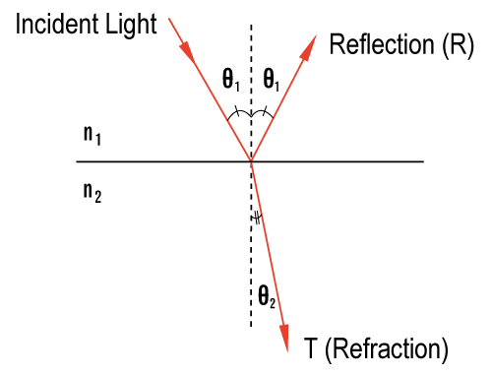
Reflection and Refraction
When light is incident at the interface of two isotropic media, part of light will be reflected and part will transmit into the second medium (at a different angle) which is called refraction.

Slide 3
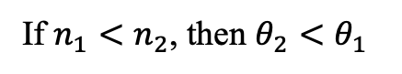
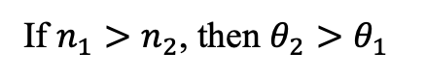
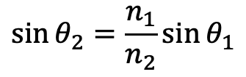
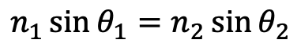
Snell’s Law
Snell’s law for refraction
$$n_{1}\sin{θ_{1}}=n_{2}\sin{θ_{2}}$$
$$\sin{θ_{2}}=\frac{n_{1}}{n_{2}}\sin{θ_{1}}$$
If $n_{1}>n_{2}$, then $θ_{2}>θ_{1}$
If $n_{1}<n_{2}$, then $θ_{2}<θ_{1}$

Slide 4
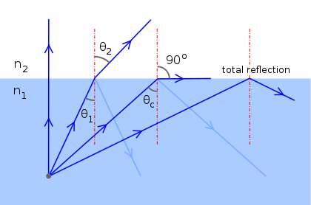
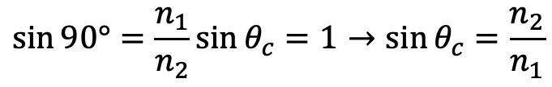
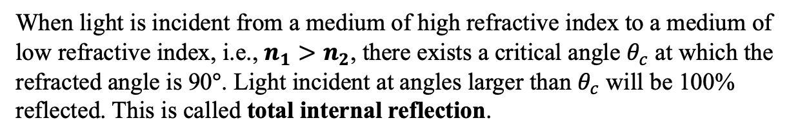
Critical Angle
When light is incident from a medium of high refractive index to a medium of low refractive index, i.e., $n_{1}>n_{2}$, there exists a critical angle $θ_{c}$ at which the refracted angle is 90$°$. Light incident at angles larger than $θ_{c}$ will be 100% reflected. This is called total internal reflection.
$$\sin{90°}=\frac{n_{1}}{n_{2}}\sin{θ_{c}}=1→\sin{θ_{c}}=\frac{n_{2}}{n_{1}}$$

Slide 5
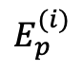
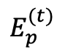
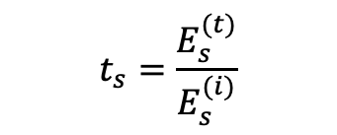

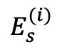

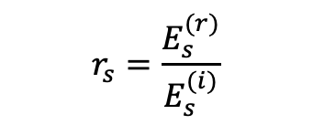
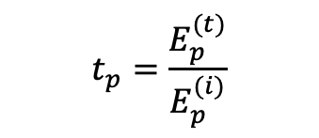

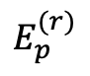
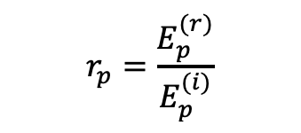


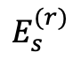
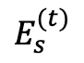
Reflectivity and Transmittivity
$$reflectivity=\frac{reflected field}{incident field}$$
$$E_{s}^{(i)}$$
$$E_{p}^{(i)}$$
$$⨀$$
$$E_{p}^{(r)}$$
$$transmittivity=\frac{transmitted field}{incident field}$$
$$⨀$$
$$E_{s}^{(r)}$$
Reflectivity and transmittivity are dependent on polarization.
p-polarization: also called transverse magnetic (TM) polarization, E-field is in the plane of incidence.
s-polarization: also called transverse electric (TE) polarization, E-field is perpendicular to the plane of incidence.
$$E_{s}^{(t)}$$
$$E_{p}^{(t)}$$
$$⨀$$
$$r_{p}=\frac{E_{p}^{(r)}}{E_{p}^{(i)}}$$
$$r_{s}=\frac{E_{s}^{(r)}}{E_{s}^{(i)}}$$
Reflectivity
$$t_{p}=\frac{E_{p}^{(t)}}{E_{p}^{(i)}}$$
$$t_{s}=\frac{E_{s}^{(t)}}{E_{s}^{(i)}}$$
Transmittivity

Slide 6

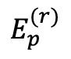
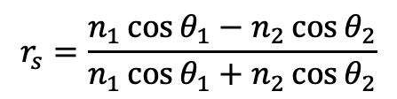

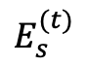
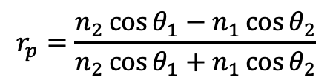
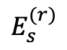
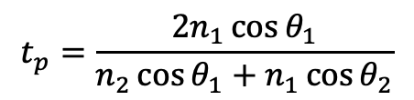
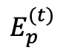
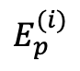
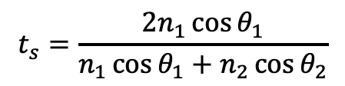
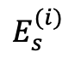

Fresnel Formulae
p-polarization (TM-polarization)
$$E_{s}^{(i)}$$
$$E_{p}^{(i)}$$
$$r_{p}=\frac{n_{2}\cos{θ_{1}−n_{1}\cos{θ_{2}}}}{n_{2}\cos{θ_{1}+n_{1}\cos{θ_{2}}}}$$
$$⨀$$
$$E_{p}^{(r)}$$
$$⨀$$
$$t_{p}=\frac{{2n}_{1}\cos{θ_{1}}}{n_{2}\cos{θ_{1}+n_{1}\cos{θ_{2}}}}$$
$$E_{s}^{(r)}$$
s-polarization (TE-polarization)
$$E_{s}^{(t)}$$
$$r_{s}=\frac{n_{1}\cos{θ_{1}−n_{2}\cos{θ_{2}}}}{n_{1}\cos{θ_{1}+n_{2}\cos{θ_{2}}}}$$
$$E_{p}^{(t)}$$
$$⨀$$
$$t_{s}=\frac{{2n}_{1}\cos{θ_{1}}}{n_{1}\cos{θ_{1}+n_{2}\cos{θ_{2}}}}$$
Reflectivity and Transmittivity of s-polarization and p-polarization are independent from each other.

Slide 7
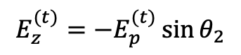
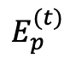
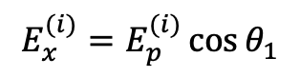
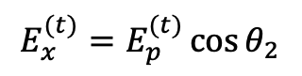
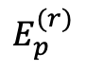
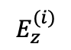
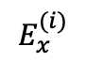
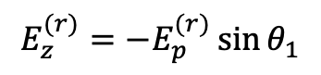
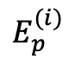
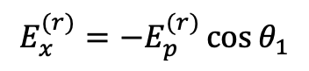

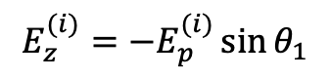
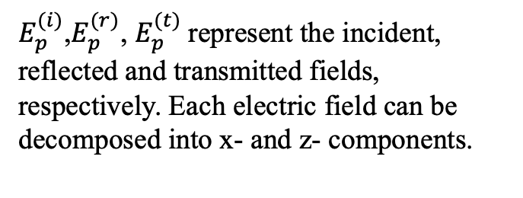
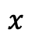
Derivation of Fresnel Formulae
(1) The case of p-polarization
$E_{p}^{(i)}$,$E_{p}^{(r)}$, $E_{p}^{(t)}$represent the incident, reflected and transmitted fields, respectively. Each electric field can be decomposed into x- and z- components.
$$E_{z}^{(i)}$$
$$E_{p}^{(i)}$$
$$E_{x}^{(i)}$$
$$E_{p}^{(r)}$$
Incident field:
$$E_{x}^{(i)}=E_{p}^{(i)}\cos{θ_{1}}$$
$$x$$
$$E_{z}^{(i)}=−E_{p}^{(i)}\sin{θ_{1}}$$
$$E_{p}^{(t)}$$
$$E_{x}^{(r)}=−E_{p}^{(r)}\cos{θ_{1}}$$
Reflected field:
$$E_{z}^{(r)}=−E_{p}^{(r)}\sin{θ_{1}}$$
$$z$$
Refracted field:
$$E_{x}^{(t)}=E_{p}^{(t)}\cos{θ_{2}}$$
$$E_{z}^{(t)}=−E_{p}^{(t)}\sin{θ_{2}}$$

Slide 8
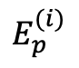
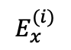
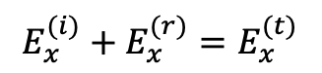

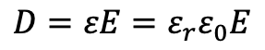
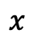
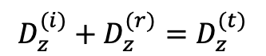
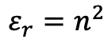
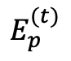
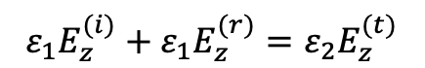


Derivation of Fresnel Formulae
Boundary Conditions
1. Tangent components of E-field are continuous across the boundary
$$E_{z}^{(i)}$$
$$E_{p}^{(i)}$$
$$E_{x}^{(i)}$$
$$E_{p}^{(r)}$$
$$E_{x}^{(i)}+E_{x}^{(r)}=E_{x}^{(t)}$$
(1)
2. Normal components of D-field are continuous across the boundary
$$x$$
$$E_{p}^{(t)}$$
$$D_{z}^{(i)}+D_{z}^{(r)}=D_{z}^{(t)}$$
$$D=εE=ε_{r}ε_{0}E$$
$$z$$
Relative permittivity
$$ε_{r}=n^{2}$$
$${ε_{1}E}_{z}^{(i)}+{ε_{1}E}_{z}^{(r)}={ε_{2}E}_{z}^{(t)}$$
(2)

Slide 9





Derivation of Fresnel Formulae
Substituting the expressions of E_{x} and E_{z} in Eq.(1) and (2), we get
$$E_{p}^{(i)}\cos{θ_{1}}−E_{p}^{\left(r\right)}\cos{θ_{1}}=E_{p}^{(t)}\cos{θ_{2}}$$
(3)
$$−ε_{1}E_{p}^{\left(i\right)}\sin{θ_{1}}−ε_{1}E_{p}^{\left(r\right)}\sin{θ_{1}}=−ε_{2}E_{p}^{(t)}\sin{θ_{2}}$$
(4)
To eliminate $E_{p}^{(t)}$,
(3)$×ε_{2}\sin{θ_{2}}+(4)×\cos{θ_{2}}$, we get
$$ε_{2}\sin{θ_{2}}\cos{θ_{1}}\left[E_{p}^{\left(i\right)}−E_{p}^{\left(r\right)}\right]−ε_{1}\sin{θ_{1}}\cos{θ_{2}}\left[E_{p}^{\left(i\right)}+E_{p}^{\left(r\right)}\right]=0$$
$$\left(ε_{2}\sin{θ_{2}}\cos{θ_{1}}−ε_{1}\sin{θ_{1}}\cos{θ_{2}}\right)E_{p}^{\left(i\right)}=(ε_{2}\sin{θ_{2}}\cos{θ_{1}}+ε_{1}\sin{θ_{1}}\cos{θ_{2}})E_{p}^{\left(r\right)}$$
$$r_{p}=\frac{E_{p}^{\left(r\right)}}{E_{p}^{\left(i\right)}}=\frac{ε_{2}\sin{θ_{2}}\cos{θ_{1}}−ε_{1}\sin{θ_{1}}\cos{θ_{2}}}{ε_{2}\sin{θ_{2}}\cos{θ_{1}}+ε_{1}\sin{θ_{1}}\cos{θ_{2}}}$$

Slide 10






$$r_{p}=\frac{E_{p}^{\left(r\right)}}{E_{p}^{\left(i\right)}}=\frac{ε_{2}\sin{θ_{2}}\cos{θ_{1}}−ε_{1}\sin{θ_{1}}\cos{θ_{2}}}{ε_{2}\sin{θ_{2}}\cos{θ_{1}}+ε_{1}\sin{θ_{1}}\cos{θ_{2}}}$$
(5)
Substituting
$$ε_{1}=n_{1}^{2}$$
$$ε_{2}=n_{2}^{2}$$
$$r_{p}=\frac{n_{2}^{2}\sin{θ_{2}}\cos{θ_{1}}−n_{1}^{2}\sin{θ_{1}}\cos{θ_{2}}}{n_{2}^{2}\sin{θ_{2}}\cos{θ_{1}}+n_{1}^{2}\sin{θ_{1}}\cos{θ_{2}}}$$
Applying Snell’s law
$$n_{1}\sin{θ_{1}}=n_{2}\sin{θ_{2}}$$
$$n_{1}^{2}\sin{θ_{1}}=n_{1}\left(n_{1}\sin{θ_{1}}\right)=n_{1}(n_{2}\sin{θ_{2}})$$
$$r_{p}=\frac{n_{2}\sin{θ_{2}}(n_{2}\cos{θ_{1}}−n_{1}\cos{θ_{2}})}{n_{2}\sin{θ_{2}}(n_{2}\cos{θ_{1}}+n_{1}\cos{θ_{2}})}=\frac{ n_{2}\cos{θ_{1}}−n_{1}\cos{θ_{2}}}{ n_{2}\cos{θ_{1}}+n_{1}\cos{θ_{2}}}$$

Slide 11







Derivation of Fresnel Formulae
Transmittivity
$E_{p}^{(i)}\cos{θ_{1}}−E_{p}^{\left(r\right)}\cos{θ_{1}}=E_{p}^{\left(t\right)}\cos{θ_{2}}$ (3)
$$\cos{θ_{1}}−\frac{E_{p}^{(r)}}{E_{p}^{(i)}}\cos{θ_{1}}=\frac{E_{p}^{(t)}}{E_{p}^{(i)}}\cos{θ_{2}}$$
Both sides divided by $E_{p}^{(i)}$
$$\cos{θ_{1}}−r_{p}\cos{θ_{1}}=t_{p}\cos{θ_{2}}$$
$$t_{p}=\frac{\cos{θ_{1}}}{\cos{θ_{2}}}(1−r_{p})=\frac{\cos{θ_{1}}}{\cos{θ_{2}}}(1−\frac{ n_{2}\cos{θ_{1}}−n_{1}\cos{θ_{2}}}{ n_{2}\cos{θ_{1}}+n_{1}\cos{θ_{2}}})$$
$$=\frac{\cos{θ_{1}}}{\cos{θ_{2}}}×\frac{ 2n_{1}\cos{θ_{2}}}{ n_{2}\cos{θ_{1}}+n_{1}\cos{θ_{2}}}$$
$$t_{p}=\frac{2n_{1}\cos{θ_{1}}}{n_{2}\cos{θ_{1}}+n_{1}\cos{θ_{2}}}$$

Slide 12







Derivation of Fresnel Formulae
(2) The case of s-polarization
$$E^{(i)}$$
For s-polarization, E-field is perpendicular to the plane of incidence and H-field is in the plane of incidence, as shown in the diagram.
It is noted that the H-fields of s-polarization are analogue to the E-fields of p-polarization (but in opposite directions). If we make the following substitutions, the results of p-polarization can be used for s-polarization.
$$E→−H$$
$$D=ε_{r}ε_{0}E→B=μ_{r}μ_{0}H$$
$$ε_{r}→μ_{r}=1$$
$$E^{(r)}$$
$$H^{(i)}$$
$$H^{(r)}$$
$$x$$
$$E^{(t)}$$
$$H^{(t)}$$
$$z$$

Slide 13







By making the following substitutions in Eq.(5) on slide 10,
$E_{p}^{\left(r\right)}→{−H}^{(r)}$, $E_{p}^{\left(i\right)}→{−H}^{(i)}$
$$ε_{1}→μ_{1}=1,ε_{2}→μ_{2}=1$$
we obtain
$$\frac{{−H}^{(r)}}{{−H}^{(i)}}=\frac{\sin{θ_{2}}\cos{θ_{1}}−\sin{θ_{1}}\cos{θ_{2}}}{\sin{θ_{2}}\cos{θ_{1}}+\sin{θ_{1}}\cos{θ_{2}}}=−\frac{\sin{(θ_{1}−θ_{2})}}{\sin{(θ_{1}+θ_{2})}}$$
(6)
According to Maxwell’s equations, the magnitude of H-field is proportional to the magnitude of E-field through $H=\frac{E}{η}$, $η$ is called impedance of the medium.
$$η=\sqrt{\frac{μ}{ε}}=\sqrt{\frac{μ_{0}}{ε_{r}ε_{0}}}=\frac{\sqrt{\frac{μ_{0}}{ε_{0}}}}{\sqrt{ε_{r}}}=\frac{η_{0}}{n}$$
$η_{0}=\sqrt{\frac{μ_{0}}{ε_{0}}}=377Ω$, impedance of vacuum
So, $H^{(r)}=\frac{n_{1}E^{(r)}}{η_{0}}$, $H^{(i)}=\frac{n_{1}E^{(i)}}{η_{0}}$
$$\frac{H^{(r)}}{H^{(i)}}=\frac{\frac{n_{1}E^{(r)}}{η_{0}}}{\frac{n_{1}E^{(i)}}{η_{0}}}=\frac{E^{(r)}}{E^{(i)}}=r_{s}$$
The left side of Eq.(6) means
Reflectivity of s-polarisation
$$r_{s}=−\frac{\sin{(θ_{1}−θ_{2})}}{\sin{(θ_{1}+θ_{2})}}$$
Therefore

Slide 14







From Eq.(6) on previous slide
$$r_{s}=\frac{\sin{θ_{2}}\cos{θ_{1}}−\sin{θ_{1}}\cos{θ_{2}}}{\sin{θ_{2}}\cos{θ_{1}}+\sin{θ_{1}}\cos{θ_{2}}}=\frac{\frac{\sin{θ_{2}}}{\sin{θ_{1}}}\cos{θ_{1}}−\cos{θ_{2}}}{\frac{\sin{θ_{2}}}{\sin{θ_{1}}}\cos{θ_{1}}+\cos{θ_{2}}}$$
$$r_{s}=\frac{\frac{n_{1}}{n_{2}}\cos{θ_{1}}−\cos{θ_{2}}}{\frac{n_{1}}{n_{2}}\cos{θ_{1}}+\cos{θ_{2}}}=\frac{n_{1}\cos{θ_{1}−n_{2}\cos{θ_{2}}}}{n_{1}\cos{θ_{1}+n_{2}\cos{θ_{2}}}}$$
From Snell’s law
$$\frac{\sin{θ_{2}}}{\sin{θ_{1}}}=\frac{n_{1}}{n_{2}}$$
, so
Transmittivity
By making similar substitutions to eq.(3) on slide 11, we obtain
$n_{1}E^{(i)}\cos{θ_{1}}−n_{1}E^{(r)}\cos{θ_{1}}=n_{2}E^{(t)}\cos{θ_{2}}$ (7)
Both sides divided by $E^{(i)}$, we obtain
$$n_{1}\cos{θ_{1}}−n_{1}\cos{θ_{1}}\frac{E^{(r)}}{E^{(i)}}=n_{2}\cos{θ_{2}}\frac{E^{(t)}}{E^{(i)}}$$
$$n_{1}\cos{θ_{1}}(1−r_{s})=n_{2}\cos{θ_{2}}t_{s}$$
$$t_{s}=\frac{n_{1}\cos{θ_{1}}(1−r_{s})}{n_{2}\cos{θ_{2}}}=\frac{{2n}_{1}\cos{θ_{1}}}{n_{1}\cos{θ_{1}+n_{2}\cos{θ_{2}}}}$$

Slide 15





Fresnel Formulae
Fresnel formulae can also be written in trigonometric forms by eliminating the refractive index $n_{1}$ and $n_{2}$ by applying Snell’s law.
$$r_{p}=\frac{\tan{(θ_{1}−θ_{2})}}{\tan{(θ_{1}+θ_{2})}}$$
$$r_{s}=−\frac{\sin{(θ_{1}−θ_{2})}}{\sin{(θ_{1}+θ_{2})}}$$
$$t_{p}=\frac{2\cos{θ_{1}}\sin{θ_{2}}}{\sin{(θ_{1}+θ_{2})}\cos{(θ_{1}−θ_{2})}}$$
$$t_{s}=\frac{2\cos{θ_{1}}\sin{θ_{2}}}{\sin{(θ_{1}+θ_{2})}}$$

Slide 16




Trigonometric Fresnel Formulae
$$r_{p}=\frac{n_{2}\cos{θ_{1}−n_{1}\cos{θ_{2}}}}{n_{2}\cos{θ_{1}+n_{1}\cos{θ_{2}}}}=\frac{\cos{θ_{1}−n_{1}/n_{2}\cos{θ_{2}}}}{\cos{θ_{1}+n_{1}/n_{2}\cos{θ_{2}}}}$$
From Snell’s law
$$n_{1}/n_{2}=\sin{θ_{2}/\sin{θ_{1}}}$$
$$r_{p}=\frac{\cos{θ_{1}−\frac{\sin{θ_{2}}}{\sin{θ_{1}}}\cos{θ_{2}}}}{\cos{θ_{1}+\frac{\sin{θ_{2}}}{\sin{θ_{1}}}\cos{θ_{2}}}}=\frac{\sin{θ_{1}}\cos{θ_{1}}−\sin{θ_{2}}\cos{θ_{2}}}{\sin{θ_{1}}\cos{θ_{1}}+\sin{θ_{2}}\cos{θ_{2}}}=\frac{sin(2{θ_{1})}−sin(2{θ_{2})}}{sin(2{θ_{1})}+sin(2{θ_{2})}}$$
$$=\frac{2sin({θ_{1}−θ_{2})}\cos{(θ_{1}+θ_{2})}}{2sin({θ_{1}+θ_{2})}\cos{(θ_{1}−θ_{2})}}=\frac{\tan{(θ_{1}−θ_{2})}}{\tan{(θ_{1}+θ_{2})}}$$
The other formulae can be obtained in similar ways

Slide 17






Brewster Angle
p$−polarisation$
s-polarised
$$r_{p}=\frac{\tan{(θ_{1}−θ_{2})}}{\tan{(θ_{1}+θ_{2})}}$$
$$90°$$
(a) Brewster angle
When $θ_{1}+θ_{2}=90°$
$$\tan\left(θ_{1}+θ_{2}\right)=∞$$
$$r_{p}=0$$
$$n_{1}\sin{θ_{b}=n_{2}\sin{θ_{2}}}=n_{2}\sin{(90°−θ_{b})}=n_{2}\cos{θ_{b}}$$
Zero-reflectance of the p-polarisation field. The reflected light is completely s-polarised
Brewster angle
$$\tan{θ_{b}}=\frac{n_{2}}{n_{1}}$$

Slide 18

Brewster Angle Polariser
Light incident on a stack of plates at the Brewster angle can be used to separate s- and p-polarisation light.
From air to glass surface
$$\tan{θ_{b}}=1.5⇒θ_{b}=56.3°$$

Slide 19

Brewster Angle Cavity
Brewster angle can be used to eliminate reflection. In a laser cavity, the window that seals the lasing medium (e.g., gases) is usually tilted with the Brewster angle so that p-polarized light can completely transmit through with the loss of reflection, while the s-polarization has loss due to reflection, so the emission of laser is linearly polarized with p-polarisation, which is desirable for many applications.
window
Brewster angle
Lasing medium

Slide 20


Brewster Angle Microscope
Brewster angle microscope: p-polarized light is incident at the Brewster angle to a liquid surface. A clean liquid surface has no reflection of p-polarized light, hence appears dark. When molecules or nanoparticles accumulate on the surface, the Brewster angle is different so that some portion of p-polarized light is reflected, therefore the molecules or nanoparticles will appear bright.
Brewster angle microscope is a powerful tool for investigating thin films (e.g., the Langmuir-Blodgett film) on liquid surface.
p-polarisation
p-polarisation
bright molecules
Dark liquid surface

Slide 21







Reflectance
$$Reflectance=\frac{Reflected power}{Incident power}$$
Reflectance of light incident from air to glass
$$Reflectance={|reflectivity|}^{2}$$
s-$polarisation$
$$R={|r|}^{2}$$
p$−polarisation$
$$R_{p}={|r_{p}|}^{2}={|\frac{n_{2}\cos{θ_{1}−n_{1}\cos{θ_{2}}}}{n_{2}\cos{θ_{1}+n_{1}\cos{θ_{2}}}}|}^{2}$$
unpolarised
$$R_{s}={|r_{s}|}^{2}={|\frac{n_{1}\cos{θ_{1}−n_{2}\cos{θ_{2}}}}{n_{1}\cos{θ_{1}+n_{2}\cos{θ_{2}}}}|}^{2}$$
Brewster angle

Slide 22










Understanding Reflectance
(a) Normal incidence, $θ_{1}=θ_{2}=0$
Reflectance of light incident from air to glass
$$R_{p}=R_{s}={\left|\frac{n_{1}−n_{2}}{n_{1}+n_{2}}\right|}^{2}$$
s-$polarisation$
(b) Grazing angle, $θ_{1}→90°$
$$\cos{θ_{1}≈0}$$
$$r_{p}=\frac{n_{2}\cos{θ_{1}−n_{1}\cos{θ_{2}}}}{n_{2}\cos{θ_{1}+n_{1}\cos{θ_{2}}}}≈−1$$
p$−polarisation$
unpolarised
$$r_{s}=\frac{n_{1}\cos{θ_{1}−n_{2}\cos{θ_{2}}}}{n_{1}\cos{θ_{1}+n_{2}\cos{θ_{2}}}}≈−1$$
$$R_{p}≈R_{s}→1$$
Strong reflection at grazing angle, e.g., sunset reflection on water surface
Brewster angle

Slide 23





Understanding Reflectance
(c) In general,
Reflectance of light incident from air to glass
$$r_{p}=\frac{\tan{(θ_{1}−θ_{2})}}{\tan{(θ_{1}+θ_{2})}}$$
s-$polarisation$
$$r_{s}=−\frac{\sin{(θ_{1}−θ_{2})}}{\sin{(θ_{1}+θ_{2})}}$$
$$\frac{R_{s}}{R_{p}}={|\frac{\cos{(θ_{1}−θ_{2})}}{\cos{(θ_{1}+θ_{2})}}|}^{2}≥1$$
p$−polarisation$
unpolarised
Reflection of s-polarisation is generally greater than that of p-polarisation, especially near the Brewster angle.
Brewster angle

Slide 24












Degree of Polarisation of Reflected Light
Degree of polarisation
$$E_{s}^{(i)}$$
$$E_{p}^{(i)}$$
$$⨀$$
$$E_{p}^{(r)}$$
$$P=\frac{\sqrt{S_{1}^{2}+S_{2}^{2}+S_{3}^{2}}}{S_{0}}$$
Unpolarised
$$⨀$$
$$E_{s}^{(r)}$$
$$\left\langle E_{x}(t)E_{y}^{∗}(t)\right\rangle =\frac{1}{T}\int_{0}^{T}{E_{s}^{(r)}e^{i(ωt−kz+δ_{x}(t))}E_{p}^{(r)}e^{−i(ωt−kz+δ_{y}(t))}dt}=\frac{E_{s}^{(r)}E_{p}^{(r)}}{T}\int_{0}^{T}{e^{−iδ(t)}dt}=0$$
Similarly, $\left\langle E_{y}(t)E_{x}^{∗}(t)\right\rangle =0$, therefore $S_{2}=S_{3}=0$
$$S_{0}={|E_{s}^{\left(r\right)}|}^{2}+{|E_{p}^{\left(r\right)}|}^{2}={(R}_{s}+R_{p})E_{0}^{2}$$
Degree of polarisation
$$S_{1}={|E_{s}^{\left(r\right)}|}^{2}−{\left|E_{p}^{\left(r\right)}\right|}^{2}={(R}_{s}−R_{p})E_{0}^{2}$$
$$P=\frac{S_{1}}{S_{0}}=\frac{R_{s}−R_{p}}{R_{s}+R_{p}}$$
$E_{0}$the magnitude of the s- and p-polarization component of incident light

Slide 25



Degree of Polarisation of Reflected Light
The degree of polarisation of reflected light at air/glass interface.
$$P=\frac{R_{s}−R_{p}}{R_{s}+R_{p}}$$
Brewster angle
s-$polarisation$
p > 50% across a broad range of incident angle
p$−polarisation$
Upon reflection, unpolarized light becomes partially polarized. The degree of polarization is maximum (100% polarised) at Brewster angle and minimum (zero) near normal and grazing incident angles.

Slide 26


Polarised Sunglasses
Sunglasses with polarized filters can block most of glare light reflected from surface, therefore improving the visibility under strong reflection condition.
View without sunglasses
View with polarized sunglasses

Slide 27

Polarised Sunglasses
Light from a horizontal surface is composed of unpolarized diffused light and specular reflection light which is mainly s-polarised. The specular reflection light can be blocked by sunglasses filters with vertical polarisation axis, therefore the view can be significantly improved.

Slide 28


Dehazing Imaging
Polarised lens can significantly improve the image quality in a hazy day.
Original image
Dehazed image with polariser

Slide 29

Dehazing Imaging
Light received by a camera is composed of two parts: direct transmission light from distant objects and the scattering light by small particles in air. The direct transmitted light is unpolarized while the scattering light is strongly polarized which can be blocked with a polarising filter, therefore the image appears clearer.

Slide 30
Dehazing Imaging
Angular dependent radiation of an electric dipole
polariser
sun
Scattering light
y
x
Camera
z
A small particle in air can be modelled as an electric dipole with dipole moments along the x- and y- direction, respectively.
Electric dipole radiates strongly in the direction perpendicular to the dipole moment, but weakly along the dipole oscillating direction.
The scattering light received by the camera is mainly from the x-dipole (as the y-dipole has no radiation towards the camera. ), so it is mainly polarized along the x-direction, hence can be blocked with a polariser along the z-direction.

Slide 31





Recap of Previous Lecture
Reflectance of light incident from air to glass
The degree of polarisation of reflected light at air/glass interface.
Brewster angle
s-$polarisation$
s-$polarisation$
p$−polarisation$
p$−polarisation$
$$P=\frac{R_{s}−R_{p}}{R_{s}+R_{p}}$$
unpolarised
Brewster angle

Slide 32







Total Internal Reflection (TIR)
When light is incident from a medium of high refractive index to a medium of low refractive index, there exists a critical angle $θ_{c}$.
Light incident from glass to air
$$\sin{θ_{c}}=\frac{n_{2}}{n_{1}}$$
Critical angle
For $θ_{1}>θ_{c}$,
$$\sin{θ_{2}}=\frac{n_{1}}{n_{2}}\sin{θ_{1}}>1$$
No real solution
Brewster angle
$$\cos{θ_{2}}=\sqrt{1−{(\sin{θ_{2})}}^{2}}=i\sqrt{{(\sin{θ_{2})}}^{2}−1}$$
$$R_{p}={|r_{p}|}^{2}={|\frac{n_{2}\cos{θ_{1}−n_{1}\cos{θ_{2}}}}{n_{2}\cos{θ_{1}+n_{1}\cos{θ_{2}}}}|}^{2}={|\frac{n_{2}\cos{θ_{1}−in_{1}\sqrt{{(\sin{θ_{2})}}^{2}−1}}}{n_{2}\cos{θ_{1}+in_{1}\sqrt{{(\sin{θ_{2})}}^{2}−1}}}|}^{2}=1$$
$$R_{s}={|r_{s}|}^{2}={|\frac{n_{1}\cos{θ_{1}−n_{2}\cos{θ_{2}}}}{n_{1}\cos{θ_{1}+n_{2}\cos{θ_{2}}}}|}^{2}={|\frac{n_{1}\cos{θ_{1}−in_{2}\sqrt{{(\sin{θ_{2})}}^{2}−1}}}{n_{1}\cos{θ_{1}+in_{2}\sqrt{{(\sin{θ_{2})}}^{2}−1}}}|}^{2}=1$$

Slide 33










Optical Fiber
Total internal reflection is exploited to guide light in conventional optical fiber
$$θ_{max}$$
$$α$$
$$θ_{c}$$
$$n_{core}>n_{clad}$$
air
Maximum incident angle:
$$\sin{θ_{max}}=n_{core}\sin{α}=n_{core}\cos{θ_{c}}$$
$$(θ_{c}=90°−α)$$
$$\sin{θ_{max}}=n_{core}\sqrt{1−{\left(\sin{θ_{c}}\right)}^{2}}=n_{core}\sqrt{1−{\left(\frac{n_{clad}}{n_{core}}\right)}^{2}}=\sqrt{n_{core}^{2}−n_{clad}^{2}}$$
Numerical aperture of fiber
$$\sin{θ_{c}=\frac{n_{clad}}{n_{core}}}$$

Slide 34


Fingerprint Recording
TIR is very sensitive to external stimuli, such as pressure, bending, touch, attachment of analyte molecules etc, therefore has been widely exploited in a broad range of sensing applications.
Finger print recording: the touch of finger breaks the TIR condition. Light is scattered from the finger and recorded by the camera underneath.

Slide 35






Light Extraction in LED
$$θ_{c}$$
$$n_{LED}$$
$$θ_{c}$$
Semiconductor
Planar LED
The refractive index of LED materials is typoically $between 2.5\sim 3.5$.
$$n_{LED}=3→\sin{θ_{c}}=\frac{1}{3}→θ_{c}=19.4°$$
Light emission of a planar LED is restricted to a cone with semi angle equal to the critical angle. Curved surfaces (such as a hemisphere) have larger escape angles, hence can significantly increase the efficiency of LED.
Hemisphere LED

Slide 36


Phase Change in Reflection
The E-field of reflected light could have different phases from that of incident light, i.e., reflection could cause a phase change of light.
$$r=\frac{E^{(r)}}{E^{(i)}}=\frac{E_{0}^{(r)}e^{iφ^{(r)}}}{E_{0}^{(i)}e^{iφ^{(i)}}}=\frac{E_{0}^{(r)}}{E_{0}^{(i)}}e^{i∆φ}$$
Reflectivity
Phase change
$$∆φ=φ^{(r)}−φ^{(i)}$$
W$hen r$ is real, $∆φ=0$ f$or r>0$; $∆φ=π$ for $r<0$.
(2) In the situation of $total internal reflection \left(θ_{1}>θ_{c}\right), r$ is complex. $∆φ$ is dependent on incident angle.

Slide 37





Phase Change in Reflection
Case I: $n_{1}<n_{2}$,
$$θ_{1}>θ_{2}$$
Light is incident from low-index medium to high-index medium
(1) s-polarisation
s-pol
$$r_{s}=−\frac{\sin\left(θ_{1}−θ_{2}\right)}{\sin\left(θ_{1}+θ_{2}\right)}<0$$
$$φ=π$$

Slide 38










Phase Change in Reflection
Case I: $n_{1}<n_{2}$,
$$θ_{1}>θ_{2}$$
(2) p-polarisation
$$r_{p}=\frac{\tan{(θ_{1}−θ_{2})}}{\tan{(θ_{1}+θ_{2})}}$$
(a) When $θ_{1}<θ_{b},$
//
$$θ_{1}+θ_{2}<90°$$
$$r_{p}>0→∆φ=0$$
(b) When $θ_{1}>θ_{b},$
Brewster angle 56.3⁰ (from air to glass)
$$θ_{1}+θ_{2}>90°$$
$$r_{p}<0→∆φ=π$$

Slide 39










Phase Change in Reflection
Case II: $n_{1}>n_{2}$,
$$θ_{1}<θ_{2}$$
Light is incident from high-index medium to low-index medium
(1) s-polarisation
$$r_{s}=−\frac{\sin{(θ_{1}−θ_{2})}}{\sin{(θ_{1}+θ_{2})}}$$
$$\frac{n_{2}}{n_{1}}=1/1.5$$
(a) When $θ_{1}<θ_{c}$
$$|Δφ_{s}|$$
$$r_{s}>0→∆φ=0$$
(b) When $θ_{1}>θ_{c}$ (total internal reflection)
$$r_{s}=\frac{n_{1}\cos{θ_{1}−in_{2}\sqrt{{(\sin{θ_{2})}}^{2}−1}}}{n_{1}\cos{θ_{1}+in_{2}\sqrt{{(\sin{θ_{2})}}^{2}−1}}}=e^{−i2α_{s}}$$
$$Δφ_{s}=−2α_{s}=−2\tan^{−1}\left(\frac{n_{2}\sqrt{{(\sin{θ_{2})}}^{2}−1}}{n_{1}\cos{θ_{1}}}\right)=−2\tan^{−1}\left(\frac{\sqrt{{(n_{1}\sin{θ_{1})}}^{2}−n_{2}^{2}}}{n_{1}\cos{θ_{1}}}\right)$$

Slide 40











Phase Change in Reflection
Case II: $n_{1}>n_{2}$,
$$θ_{1}<θ_{2}$$
(2) p-polarisation
$$r_{p}=\frac{\tan{(θ_{1}−θ_{2})}}{\tan{(θ_{1}+θ_{2})}}$$
(a) When $θ_{1}<θ_{c}$
When $θ_{1}<θ_{b},$
$$r_{p}<0→∆φ=π$$
$$|Δφ_{p}|$$
When $θ_{1}>θ_{b},$
$$r_{p}>0→∆φ=0$$
$$\frac{n_{2}}{n_{1}}=1/1.5$$
(b) When $θ_{1}>θ_{c}$ (total internal reflection)
$$r_{p}=\frac{n_{2}\cos{θ_{1}−in_{1}\sqrt{{(\sin{θ_{2})}}^{2}−1}}}{n_{2}\cos{θ_{1}+in_{1}\sqrt{{(\sin{θ_{2})}}^{2}−1}}}=e^{−i2α_{p}}$$
$$Δφ_{p}=−2α_{p}=−2\tan^{−1}\left(\frac{n_{1}\sqrt{{(\sin{θ_{2})}}^{2}−1}}{n_{2}\cos{θ_{1}}}\right)=−2\tan^{−1}\left(\frac{n_{1}\sqrt{{(n_{1}\sin{θ_{1})}}^{2}−n_{2}^{2}}}{n_{2}^{2}cos{θ_{1}}}\right)$$

Slide 41


Phase Change in Transmission
$$t_{p}=\frac{{2n}_{1}\cos{θ_{1}}}{n_{2}\cos{θ_{1}+n_{1}\cos{θ_{2}}}}>0$$
$$t_{s}=\frac{{2n}_{1}\cos{θ_{1}}}{n_{1}\cos{θ_{1}+n_{2}\cos{θ_{2}}}}>0$$
Zero phase change of transmitted fields

Slide 42












45$°$ Phase Difference
Knowing the phase change in reflection and transmission has significant implications in many applications, such as anti-reflection coating, interferometers, polarimetry, ellipsometry etc.
One of the applications of phase change in TIR is to construct phase retarders. Of particular importance is the incident angle $θ_{0}$where the phase difference between p- and s- polarization is 45$°$.
$$δ\left(θ_{0}\right)=Δφ_{p}−Δφ_{s}=±\frac{π}{4}$$
$$2\tan^{−1}\left(\frac{\sqrt{{(n_{1}\sin{θ_{0})}}^{2}−n_{2}^{2}}}{n_{1}\cos{θ_{0}}}\right)−2\tan^{−1}\left(\frac{n_{1}\sqrt{{(n_{1}\sin{θ_{0})}}^{2}−n_{2}^{2}}}{n_{2}^{2}cos{θ_{0}}}\right)=±\frac{π}{4}$$
For example:
$n_{1}=1.5$, $n_{2}=1$
$θ_{0}=50.2°$ or 53.3$°$
$$E_{p}^{(i)}$$
$$E_{p}^{(r)}$$
$$E_{s}^{(r)}$$
$$θ_{0}$$
$$θ_{0}$$
$$E_{s}^{(i)}$$

Slide 43







Fresnel Rhomb
One TIR at $θ_{0}$ induces 45$°$ phase change, two TIR will induce 90$°$phase change (equivalent to a quarter waveplate), …four TIR will induce 180$°$phase change (equivalent to a half waveplate).
A slab of crystal is cut to a tilt angle of $θ_{0}$. Light incident normal to the surface undergo TIR inside the crystal will induce the desired phase change. Such device is called Fresnel rhomb.
$$θ_{0}$$
$$θ_{0}$$
$$θ_{0}$$
$$θ_{0}$$
Quarter-wave Fresnel rhomb retarder
Half-wave Fresnel rhomb retarder

Slide 44




Transmittance
Transmittivity
$$E_{s}^{(i)}$$
$$E_{p}^{(i)}$$
$$⨀$$
$$E_{p}^{(r)}$$
$$t_{p}=\frac{E_{p}^{(t)}}{E_{p}^{(i)}}=\frac{{2n}_{1}\cos{θ_{1}}}{n_{2}\cos{θ_{1}+n_{1}\cos{θ_{2}}}}$$
$$⨀$$
$$E_{s}^{(r)}$$
$$t_{s}=\frac{E_{s}^{(t)}}{E_{s}^{(i)}}=\frac{{2n}_{1}\cos{θ_{1}}}{n_{1}\cos{θ_{1}+n_{2}\cos{θ_{2}}}}$$
$$E_{s}^{(t)}$$
$$E_{p}^{(t)}$$
$$⨀$$
$$transmittance(T)=\frac{transmitted power}{incident power}$$
$$transmittance(T)≠{|transmittivity|}^{2}$$
Because the refracted angle $θ_{2}$ is different from that of incident angle $θ_{1}$, and the two media have different refractive indexes.

Slide 45
















Transmittance
Poynting vector: energy flow across unit area in unit time
$$A_{1}$$
$$S=E×H$$
$$n_{1}$$
$$θ_{1}$$
$$H=\frac{nE}{η_{0}}$$
$η_{0}=\sqrt{\frac{μ_{0}}{ε_{0}}}=377Ω$, impedance of vacuum
$$n_{2}$$
$$A$$
$$θ_{2}$$
$$S=\frac{nE^{2}}{η_{0}}$$
Magnitude of Poynting vector
$$A_{2}$$
$$A_{1}=A\cos{θ_{1}}$$
$$A_{2}=A\cos{θ_{2}}$$
Transmittance
Incident power $P_{i}=S_{1}A_{1}=\frac{n_{1}A\cos{θ_{1}}{|E^{\left(i\right)}|}^{2}}{η_{0}}$
$$T=\frac{P_{t}}{P_{i}}=\frac{n_{2}\cos{θ_{2}}}{n_{1}\cos{θ_{1}}}{|t|}^{2}$$
Transmitted power $P_{t}=S_{2}A_{2}=\frac{n_{2}\operatorname{Acos}{θ_{2}}{|E^{\left(t\right)}|}^{2}}{η_{0}}$

Slide 46





Transmittance
Energy conservation law requires:
$$reflectance (R)+transmittance(T)=1$$
$$T=1−R$$
s-$polarisation$
p$−polarisation$
unpolarised
Transmittance of light through a dielectric with refractive index of 1.5 as a function of incident angle

Slide 47













Evanescent Field
Boundary conditions indicate that the tangent (normal) components of E and H (D and B) fields must be continuous across the interface.
$$z$$
?
?
$$n_{2}$$
$$x$$
In medium 1, the total electric fields both along (tangent component) and normal to the boundary are nonzero.
$$n_{1}$$
$$θ_{1}$$
$$θ_{1}$$
$$E_{s}^{(r)}$$
$$E_{s}^{(i)}$$
$$⨀$$
$$⨀$$
$$E_{p}^{(i)}$$
$$E_{p}^{(r)}$$
$$E_{x}^{(i)}+E_{x}^{(r)}≠0$$
Total internal reflection
$$E_{z}^{(i)}+E_{z}^{(r)}≠0$$
Is there any field in medium 2?
Therefore, according to the Boundary Conditions, there must be electromagnetic fields in medium 2.

Slide 48



















Evanescent Field
$k_{x}=k\sin{θ_{2}}$ the x-component of wavevector k
$$z$$
z
$k_{z}=k\cos{θ_{2}}$ the z-component of wavevector k
$$k=n_{2}k_{0}$$
$$\cos{θ_{2}}=i\sqrt{{(\sin{θ_{2})}}^{2}−1}$$
$$n_{2}$$
$$θ_{2}$$
$$x$$
$$n_{1}$$
$$k_{z}=n_{2}k_{0}\cos{θ_{2}}=in_{2}k_{0}\sqrt{{(\sin{θ_{2})}}^{2}−1}=ik_{0}\sqrt{{(n_{2}\sin{θ_{2})}}^{2}−n_{2}^{2}}=ik_{0}\sqrt{{(n_{1}\sin{θ_{1})}}^{2}−n_{2}^{2}}$$
$$θ_{1}$$
$$θ_{1}$$
$$E_{s}^{(r)}$$
$$E_{s}^{(i)}$$
$$⨀$$
$$⨀$$
$$E_{p}^{(i)}$$
$$E_{p}^{(r)}$$
$$k_{x}=n_{2}k_{0}\sin{θ_{2}}=n_{1}\sin{θ_{1}}k_{0}$$
Total internal reflection
$$E=Ae^{i(n_{1}\sin{θ_{1}}k_{0}x+ik_{0}z\sqrt{{(n_{1}\sin{θ_{1})}}^{2}−n_{2}^{2}}−ωt)}=Ae^{−k_{0}z\sqrt{{(n_{1}\sin{θ_{1})}}^{2}−n_{2}^{2}}}e^{i(n_{1}\sin{θ_{1}}k_{0}x−ωt)}$$
The general form of the electric fields in medium 2 can be written as
Exponentially decay along z-direction
Propagating along x-direction
$$E=Ae^{i(k_{x}x+k_{z}z−ωt)}$$
(1)
Evanescent field

Slide 49


Evanescent Field
$$z$$
Evanescent field
For evanescent field, time averaged Poynting vector along the z-direction is zero, which means no optical energy is transported along the z-direction. All optical energy is transported to the reflected beam, so energy conservation law is preserved.
However, the electric (and magnetic) fields in medium 2 are nonzero. When an object is brought very close to the surface, it will experience the effects of the evanescent fields in a similar way to that of normal optical fields.
$$n_{2}$$
$$x$$
$$n_{1}$$
$$θ_{1}$$
$$θ_{1}$$
Total internal reflection
Poynting vector:
$$S=E×H$$
$$\left\langle S_{z}(t)\right\rangle =0$$

Slide 50





Evanescent Field
$$z$$
$$n_{2}$$
$$x$$
$$n_{1}$$
$$θ_{1}$$
$$θ_{1}$$
A particle or molecule placed near the surface will experience the evanescent fields and scatter or emit (e.g., fluorescence) light

Slide 51


Total Internal Reflection Fluorescence Microscope
Total internal reflection fluorescence microscope (TIRFM) ‘illuminates’ cells or molecules with evanescent fields via total internal reflection. There are several advantages of TIRFM in comparison to conventional widefield fluorescence microscope
Short imaging depth: as evanescent fields decay exponentially with distance, only a thin layer (roughly <100 nm) of cell specimen very close to the surface is excited, which decrease the blurring effect due to out of focus effect often occurred in conventional fluorescence microscope.
No background signal, so high contrast image.

